Slide 1

Welcome
Year 9 Parent Information Evening
Tuesday 21 November 2017

Slide 2

Year 9 Parent Information Evening
Welcome: Student Progress Leader, Mrs Jean-Baptiste
* Science at KS4 (Ms Kazi, KS4 Deputy Head of Science Faculty)
* Assessment System/ Measuring Progress (Mr Shackson, Assistant Headteacher)
* GCSEs (Mr Shackson, Assistant Headteacher)
* GREEN (Ms Phillipou, Assistant Headteacher)
* Internet Safety (Mr Gunzi, Deputy Headteacher)
* Screen Time (Mrs Jean-Baptiste)
Close
*

Slide 3
Key Stage 4 Science
Ms Kazi
KS4 Deputy Head of Faculty

Slide 4

What Science courses do we offer?
Combined Science: Two GCSEs
  9 lessons per fortnight
  Y9 Students have already started KS4 since Sept 2017
Separate Science: Three GCSEs:
  Previously called Triple Science
  Biology, Chemistry, Physics
  9 lessons per fortnight
  Specialist teachers

Slide 5
How does my daughter get into Separate Science?
Entry test on Wednesday 7th February
Letters are given out to targeted students
If students are interested they can request a letter
Letter gives guidance on what to study for test
A good Level 6> is recommended
More information also available on Options evening

Slide 6
What do I need to do now?
Have a discussion with your daughter
Things to think about:
  Does she intend to study science at A-level?
  Is she prepared for the extra workload of triple science?
  Skills she will need: Time-management, organisation, self-motivation, committed, hardworking

Slide 7
Assessment System/ Measuring Progress
( Mr Shackson
Assistant Headteacher)

Slide 8
Attainment
Progress
Exceeding the expected progress
Making good progress
Not making the expected progress

Slide 9
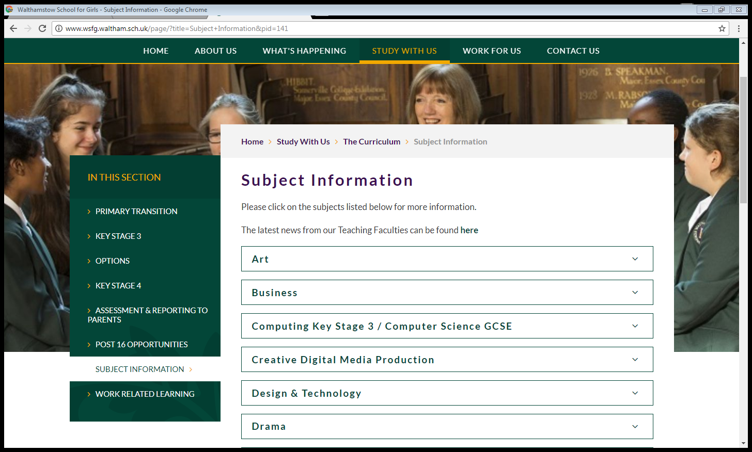

Slide 10
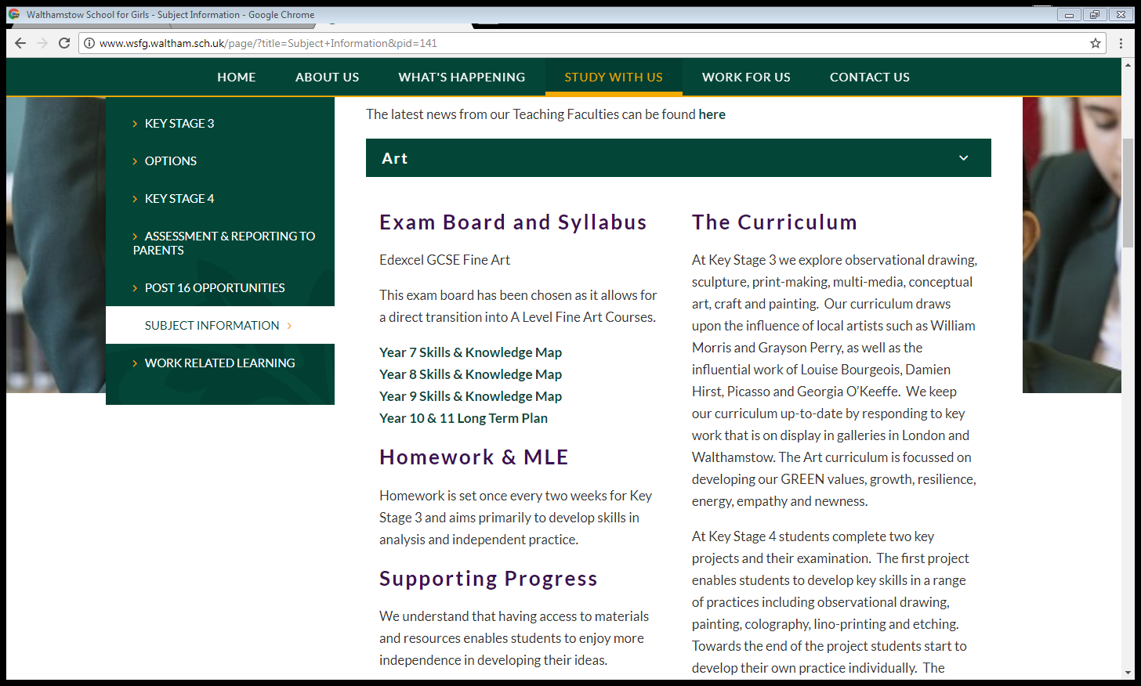

Slide 11
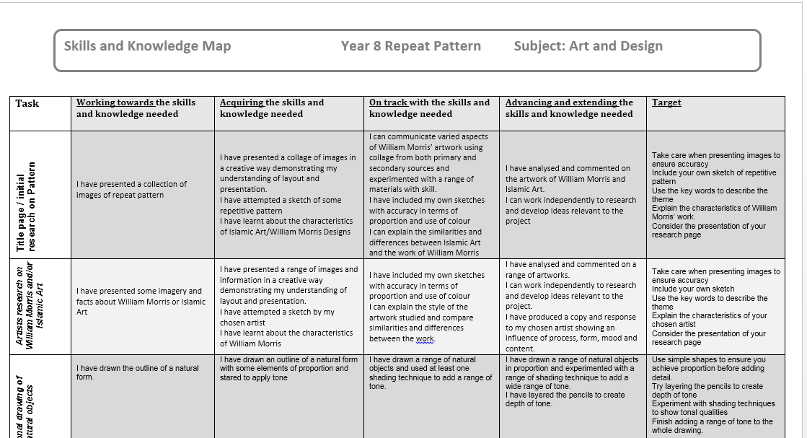
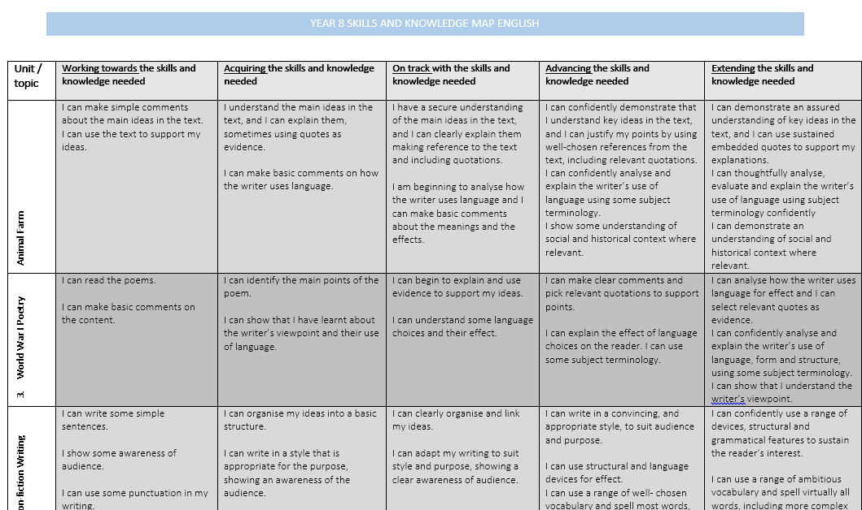

Slide 12
Attainment 8
Average Grade for 8 “best” subjects
Mathematics
English or Literature
3 Ebacc Subjects (MFL, Sciences or Humanities)
3 Other Subjects

Slide 13
Progress 8
The Average Grade (Attainment) is compared nationally
Average expected grade for each student is worked out based on Primary Results
Difference is the Progress 8

Slide 14
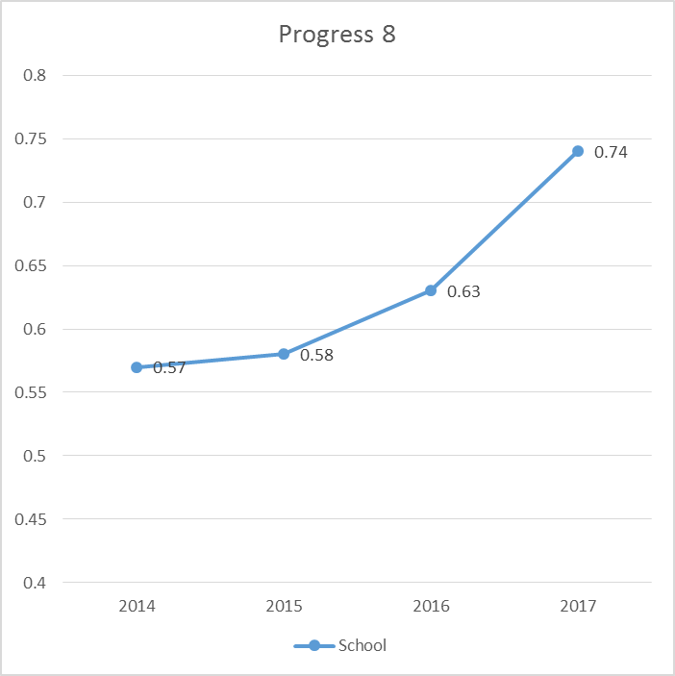

Slide 15
English Baccalaureate (Ebacc)
Good pass in 5 GCSE subjects (5+)
English
Mathematics
Science
Language
Humanities

Slide 16
GREEN

Slide 17
A person who never made a mistake never tried anything new.
Albert Einstein
When everything seems to be going against you, remember that the airplane takes off against the wind, not with it. Henry Ford
The greatest glory in living lies not in never falling, but in rising every time we fall. Nelson Mandela
When we tackle obstacles, we find hidden reserves of courage and resilience we did not know we had. And it is only when we are faced with failure do we realise that these resources were always there within us. We only need to find them and move on with our lives.
A. P. J. Abdul Kalam
Notes:
Students reflect as they enter assembly. Appropriate music?
Ask questions on past experience - something they have found difficult in life? School? How did they deal with it. Did they persevere? Did they want to give up?etc

Slide 18
BE
KNOW
DO

Slide 19
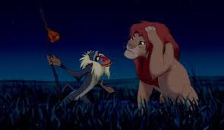
https://www.youtube.com/watch?v=ikHyDwyqdRM
Notes:
Clap activity - how long do we live for?
Talk further about resilience and facing up to difficult situations. Can’t live in the past or fear the future.

Slide 20
BE
KNOW
DO

Slide 21
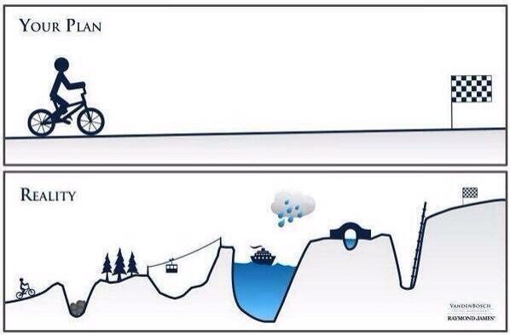
Be
Know
Know
Do
Do
Notes:
Life doesn’t always go to plan. Always have ups and downs. This is why we must build the skills so that we can face challenges life throws at us. So that we are not afraid t omake mistakes but so that we can deal with them.
This is the same about learning. Now think of a lesson they have been in recently where they found something hard / wanted to give up.

Slide 22
Be
Know
Know
Do
Do
Notes:
Life doesn’t always go to plan. Always have ups and downs. This is why we must build the skills so that we can face challenges life throws at us. So that we are not afraid t omake mistakes but so that we can deal with them.
This is the same about learning. Now think of a lesson they have been in recently where they found something hard / wanted to give up.

Slide 23
BE
BE
BE
KNOW
Know
KNOW
KNOW
Know
Know
DO
Do
DO
Do
DO
Do
Notes:
Life doesn’t always go to plan. Always have ups and downs. This is why we must build the skills so that we can face challenges life throws at us. So that we are not afraid t omake mistakes but so that we can deal with them.
This is the same about learning. Now think of a lesson they have been in recently where they found something hard / wanted to give up.

Slide 24





Analytical
Focused
Forward thinking
Creative
GROWTH
RESILIENCE
ENERGY
EMPATHY
NEWNESS
Adventurous
Attentive
Inquisitive
Reflective
Independent
Empathetic
Resilient
Collaborative
Open-minded
Enthusiastic
Adaptable
Observant
Methodical

Slide 25
https://www.youtube.com/watch?v=M4byjLIeS5Y
A person who never made a mistake never tried anything new. –Albert Einstein
When everything seems to be going against you, remember that the airplane takes off against the wind, not with it. –Henry Ford
The greatest glory in living lies not in never falling, but in rising every time we fall.” ― Nelson Mandela
When we tackle obstacles, we find hidden reserves of courage and resilience we did not know we had. And it is only when we are faced with failure do we realise that these resources were always there within us. We only need to find them and move on with our lives. A. P. J. Abdul Kalam
Notes:
Revisit quotes for final reflection following what they have learnt today.
Ask students to try and use the learning line in at least one lesson today and see if they find it useful. If they did - keep using it!

Slide 26
Internet Safety
Mr Gunzi, Deputy Headteacher KS3

Slide 27

E-Safety

Slide 28
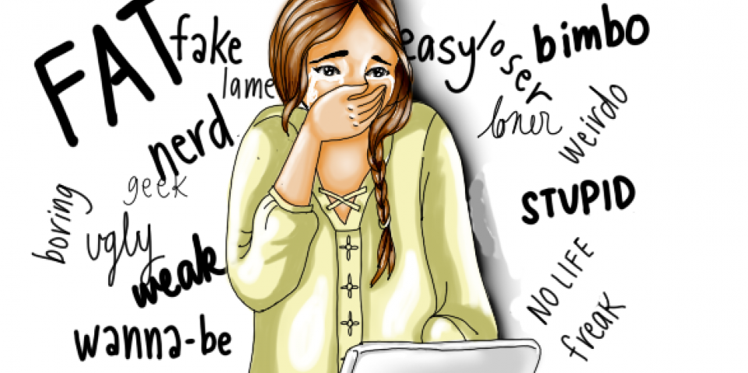
E-Safety Issues
Cyber Bullying
Cyberbullying is the use of new technology, in particular mobile phones and the internet, to deliberately upset someone else.

Slide 29
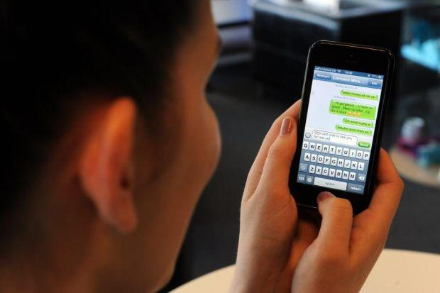
E-Safety Issues
Online Grooming
Grooming is when someone builds an emotional connection with a child to gain their trust for the purposes of sexual abuse, sexual exploitation or trafficking.

Slide 30
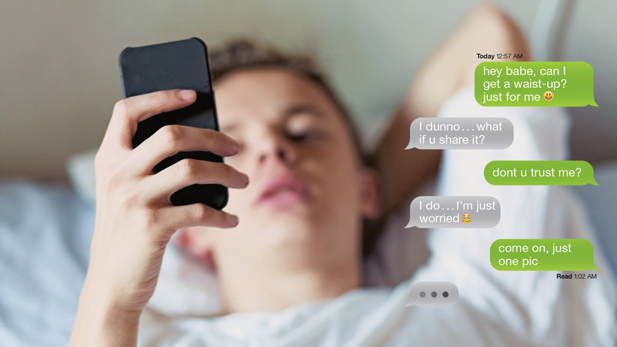
E-Safety Issues
Sexting
'Sexting' describes the use of technology to share sexual and sexually implied content.
This content includes texts, photos of partial nudity and sexual images or video.
This could be shared between partners, peers and strangers.

Slide 31
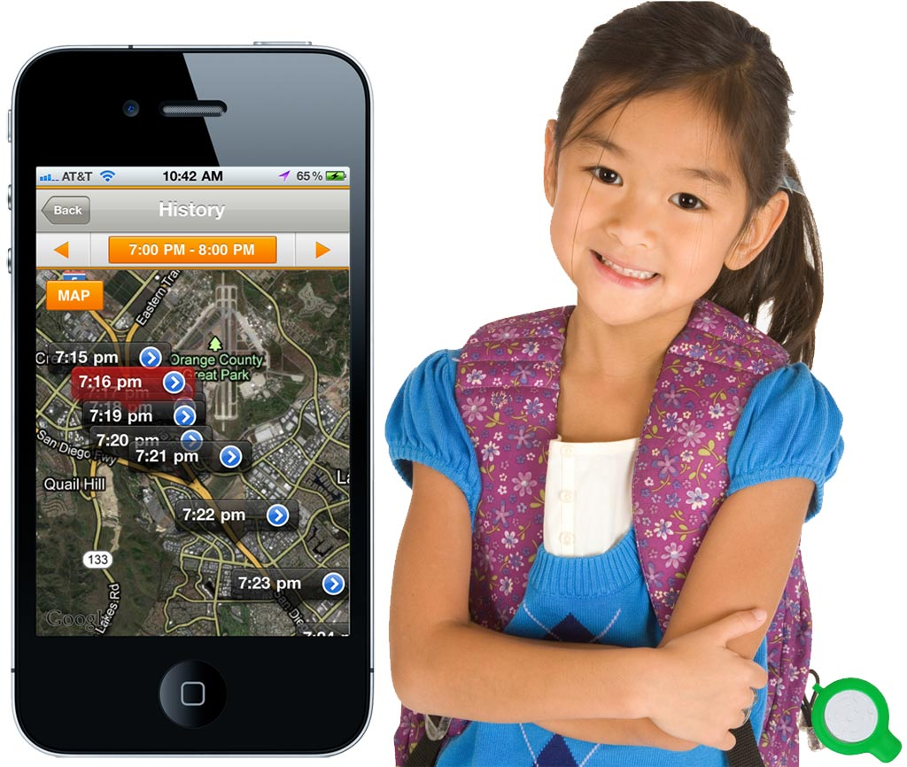
E-Safety Issues
Location Services
There are many location-based apps available for mobile devices, making it easier than ever to show your friends and family where you are at any given time.
Do you want everyone to know where you are?

Slide 32
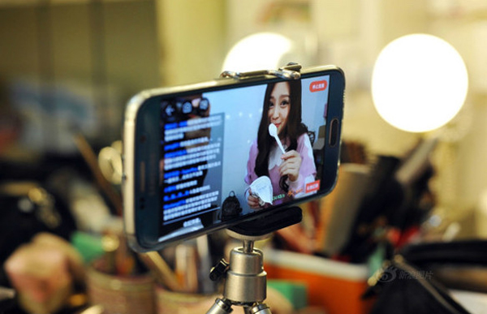
E-Safety Issues
Livestreaming
Livestreaming is becoming a very popular way for people to broadcast themselves on apps such as Instagram Live, Facebook Live, Periscope, Twitch and YouTube Live.
Do you know what you will see?

Slide 33
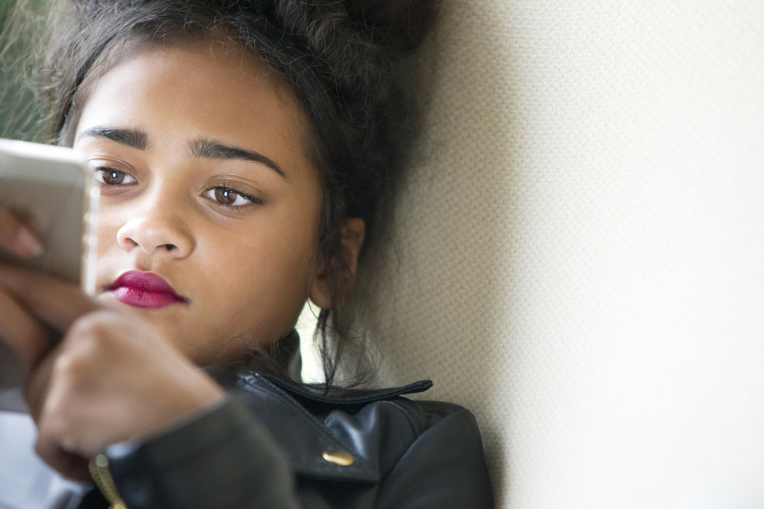
E-Safety Issues
Gaming Communities
There are so many ways for users to play games online. Many online games are multi-player and you cannot be sure who you are playing with.

Slide 34
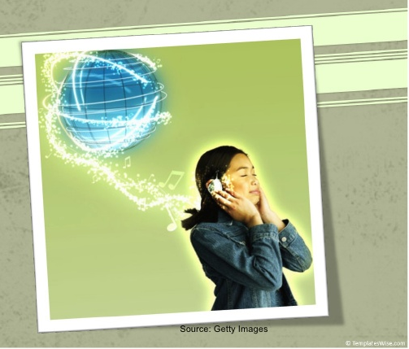
E-Safety Issues
Illegal File Sharing
Copyright law applies to downloading, sharing and streaming.
If you make content available to others on a file-sharing network, download from an illegal site, or sell copies without the permission of those who own the copyright, then you could face serious penalties.

Slide 35
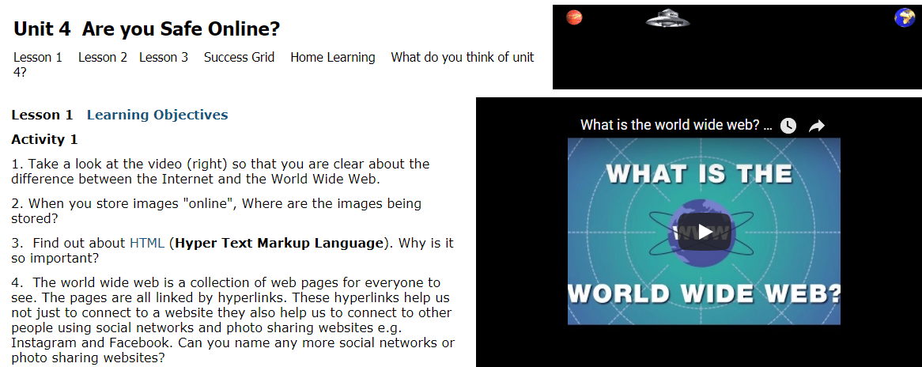
What do we do at WSFG to protect your daughter?
E-Safety issues taught in computing and citizenship lessons.

Slide 36
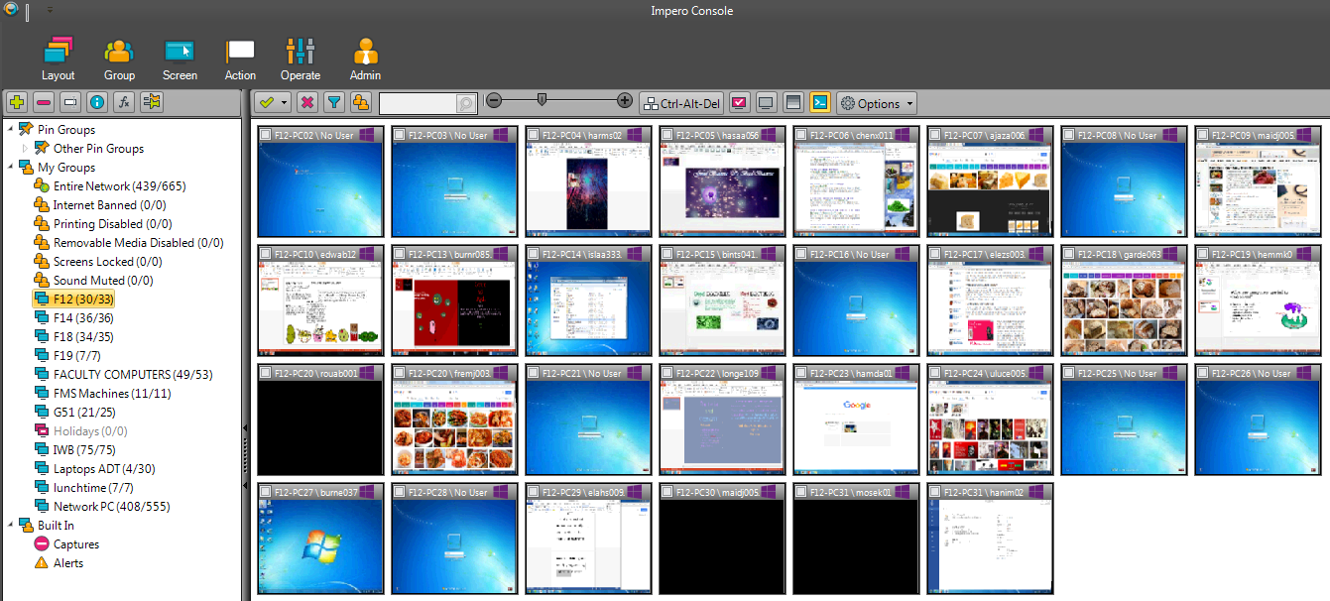
What do we do at WSFG to protect your daughter?
Impero is used to ensure students are making educational use of online services. Inappropriate use can be acted upon.

Slide 37

What do we do at WSFG to protect your daughter?
The Internet is filtered to prevent access to inappropriate websites.

Slide 38

What do we do at WSFG to protect your daughter?
No mobile phones policy – Students must hand in their mobile phone to the school office when they arrive in school.

Slide 39
What can you do to protect your daughter?
Have a conversation with your daughter - encourage them to talk to you about their internet use.
Tell your daughter that she should tell you or a teacher if they see something inappropriate online.
Use a filter e.g. Net nanny to block inappropriate content.

Slide 40
What can you do to protect your daughter?
Encourage your daughter to think before she posts to a social network.
Make sure that you and your daughter understand how to manage privacy settings on social networks.
If your child is being cyber-bullied save all evidence and report this to the school or in the case of more serious issues the police.

Slide 41
What can you do to protect your daughter?
Set up a family email address that your daughter can use to set up new online accounts.
Encourage your daughter to use a nickname, rather than her real name, to protect her online identity.
Make sure that your daughter uses a strong password and changes this for each online account and any devices that she has access to.

Slide 42
More Information
http://parentinfo.org/
www.childnet.com
www.childline.org.uk/info-advice/
http://www.bullying.co.uk/cyberbullying/
www.getsafeonline.org
http://www.kidsmart.org.uk/
www.ceop.police.uk/safety-centre/

Slide 43
Screen Time

Slide 44
Screen Time & Bed Time
Phones, tablets and other electronic devices should be switched off at least one hour before bedtime to ensure a good night’s sleep
Please do not let your daughter sleep with her mobile phone
You cannot ‘police’ her use
You cannot keep her safe
Her sleep will be disrupted – bright blue light – notification temptation!
Sleep is hugely important for brain health, stress management, memory
Please store all electronic devices away from your child’s bedroom until morning
Buy them an old fashioned clock radio alarm
WE WILL BE SPEAKING TO THE GIRLS ABOUT THIS IN ASSEMBLY

Slide 45
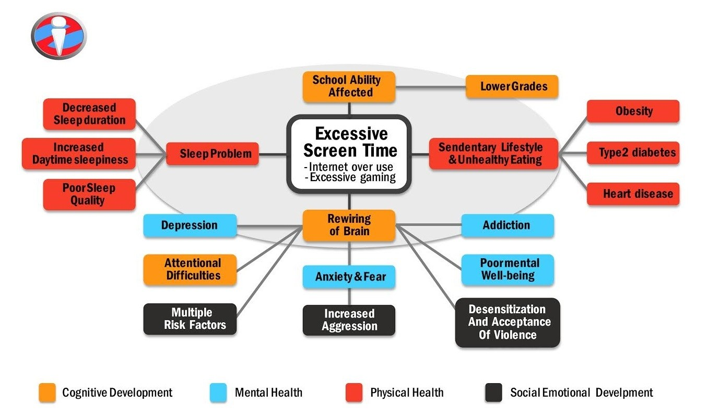

Slide 46
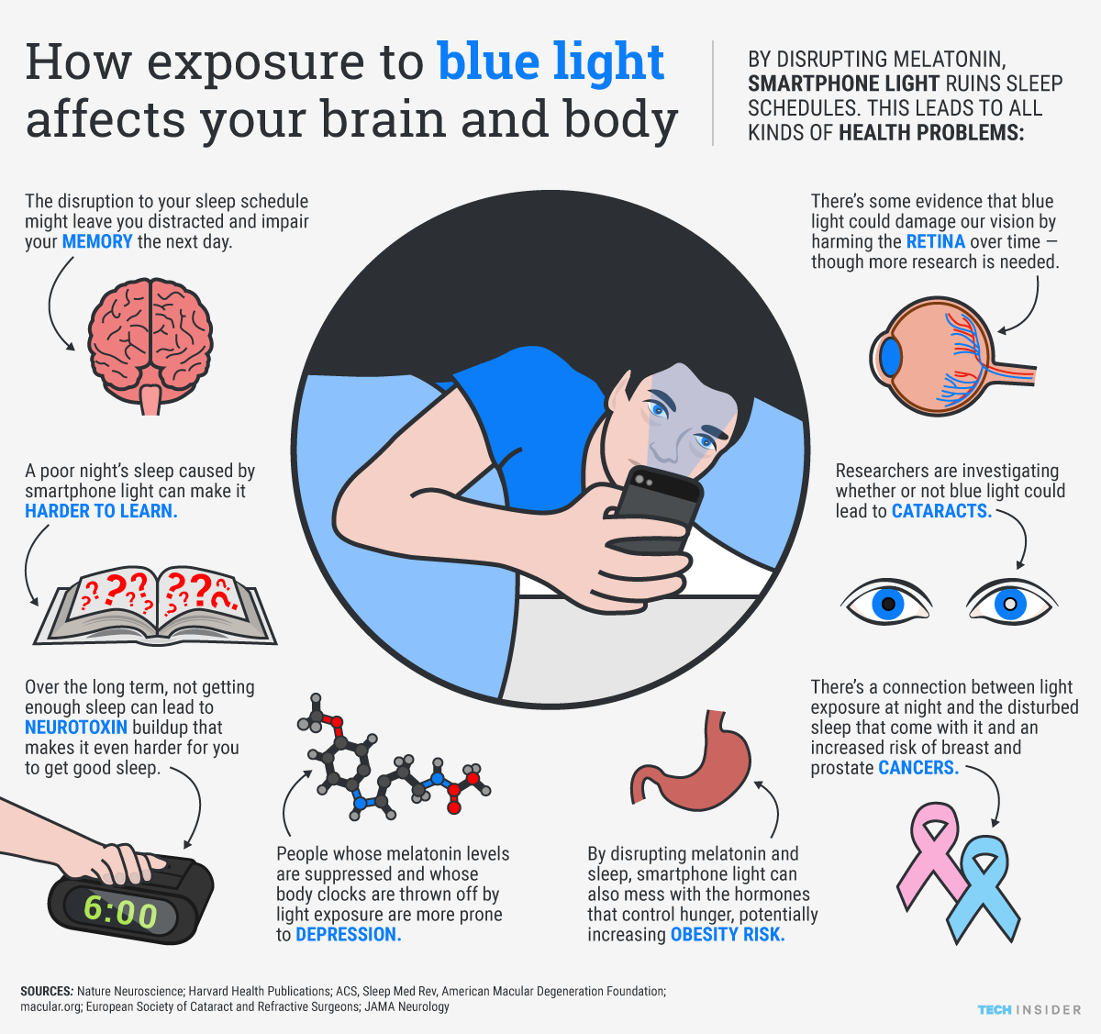

Slide 47
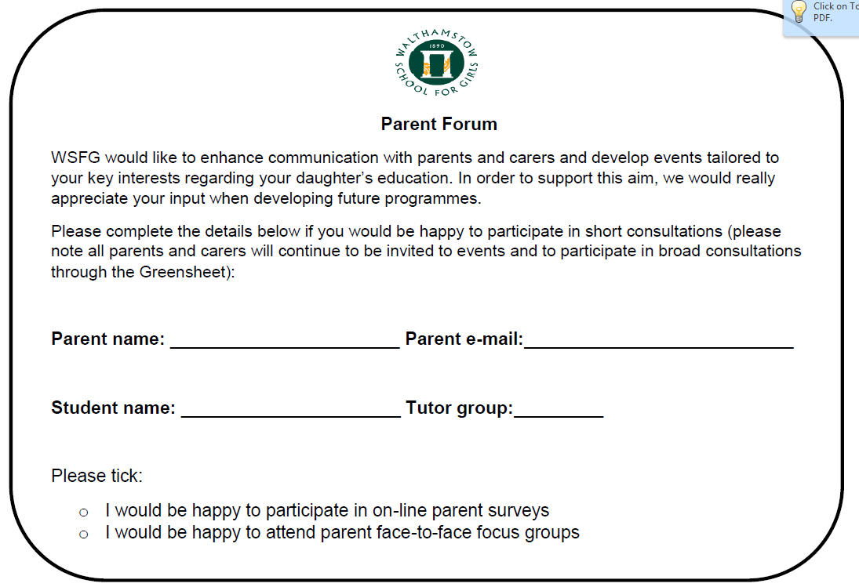

Slide 48
Thank you for your time
Parent forum slips – collect from the back and hand to
Mrs Jean-Baptiste

