Slide 1

CANNABIS
EDIBLES.
INFORMATION AND ADVICE FOR CHILDREN, PARENTS AND PROFESSIONALS

Slide 2

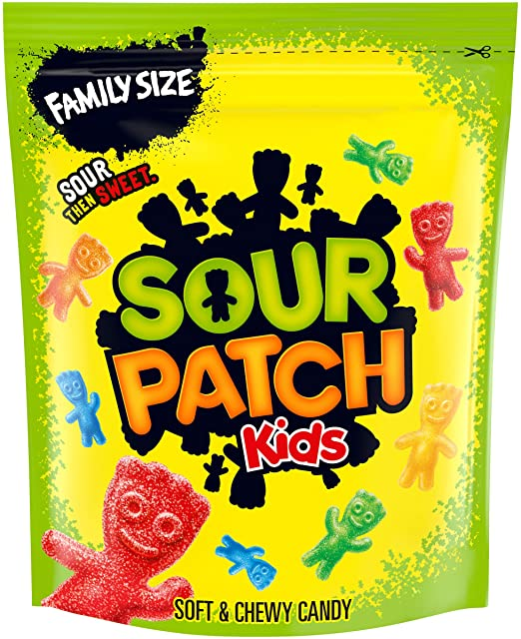
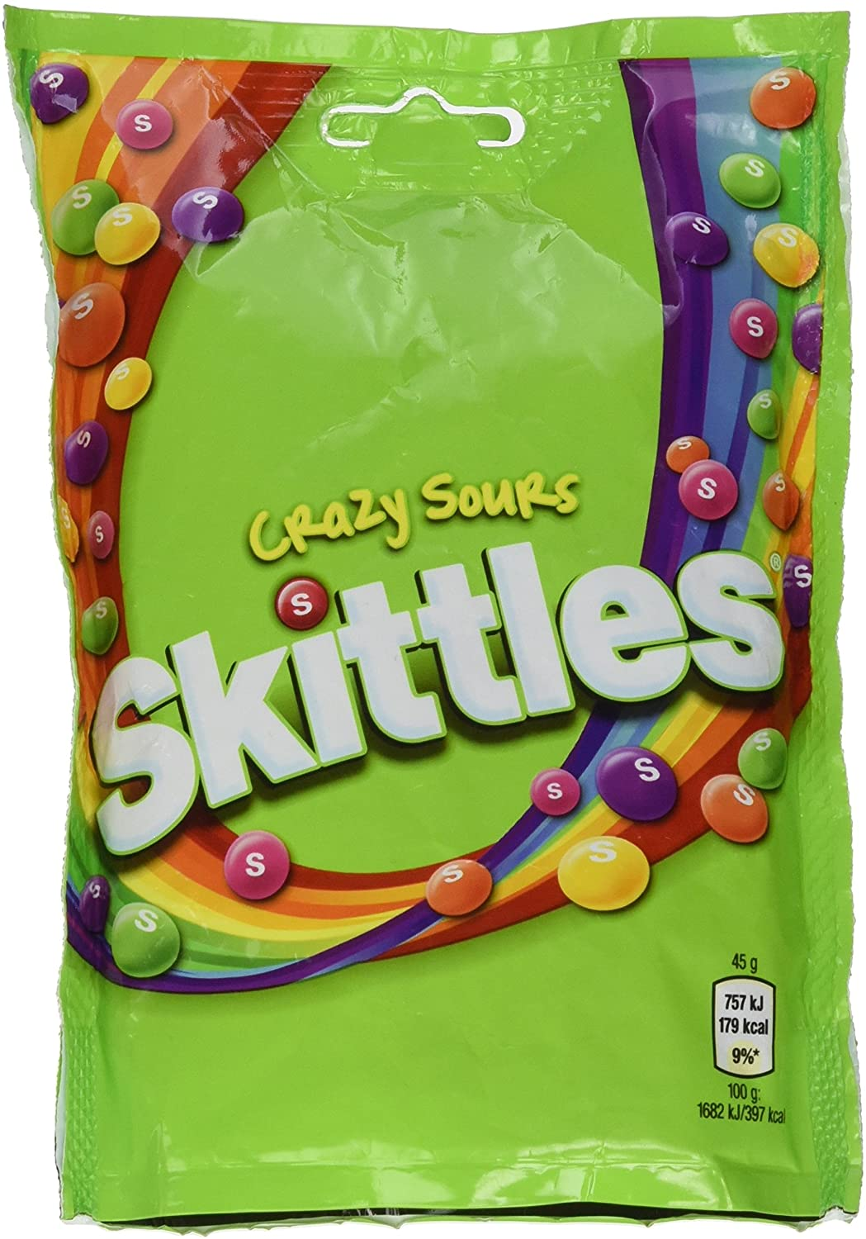
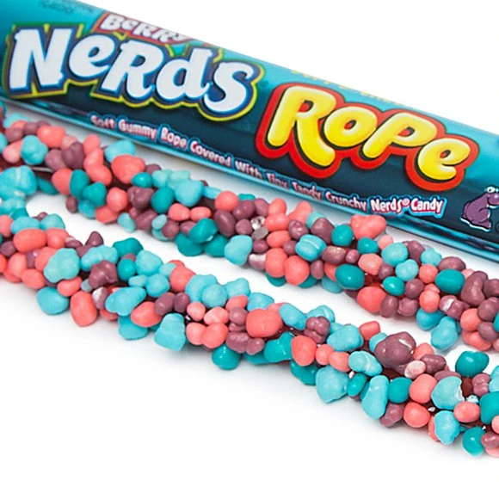
WHAT ARE CANNABIS EDIBLES?
Laced with a THC the active ingredient in Cannabis, edibles are a Class B drug and really strong ‘sweet’ aimed at young people.
They are disguised in the form of sweets, chocolate and drinks. Although cannabis edibles contain an
element of cannabis, they do not have the smell or appearance of cannabis. Instead, they look and smell like commercially purchased items but can be much stronger than other cannabis products.
CAN YOU IDENTIFY CANNABIS EDIBLES?
Cannabis edibles can be difficult to identify. Sometimes the packaging differs slightly from shop bought items. Differences can be in appearance, spelling or poor quality packaging. Sometimes the only giveaway is the addition of a Cannabis leaf symbol or the letters THC. Below are some examples of shop bought items and how they compare to cannabis edibles.
Artwork changed slightly and has the edition of POT tart and strength info to distinguish
Addition of Cannabis leaf designs and slightly altered wording
Addition of Cannabis leaf designs and slightly altered wording
Due to being illegal in the UK, Cannabis edibles are generally purchased through social media platforms such as Snapchat, TikTok, and Instagram. The use of these platforms make it extremely easy for our young persons to access these drugs with the click of a button.
Addition of Cannabis leaf designs and slightly altered wording

Slide 3
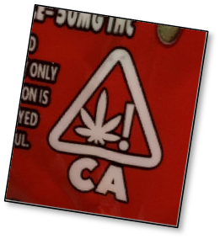
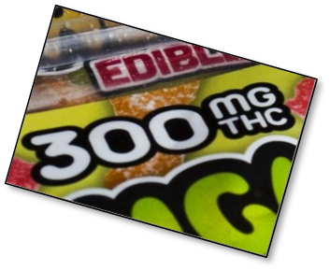
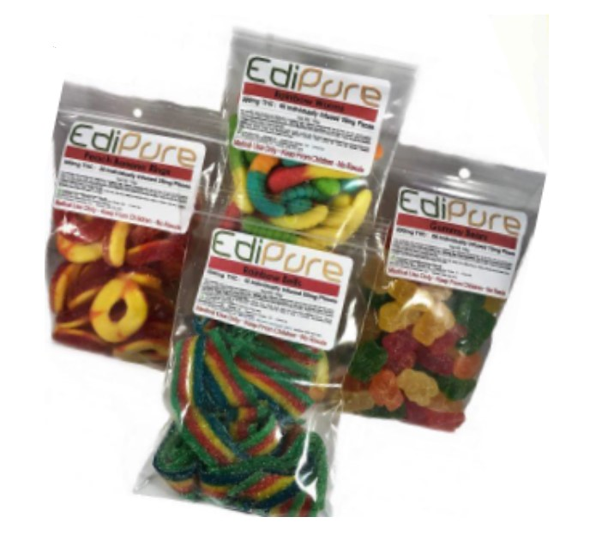
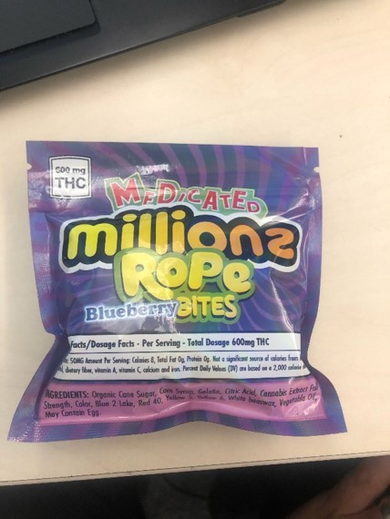
WHAT ARE THE EFFECTS OF EDIBLES ?
Cannabis edibles can be much stronger than other cannabis products. Unlike smoking cannabis, swallowing cannabis makes it much easier to consume but longer to take effect. Young people are likely to eat too many due to the delayed effects. Eating one sweet is roughly equivalent to smoking one cannabis joint.

Slide 4
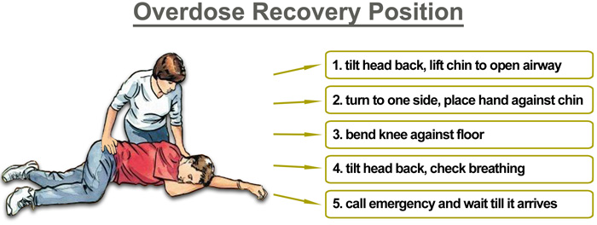
MY CHILD HAS TAKEN CANNABIS EDIBLES WHAT DO I DO?
The most important thing is not to panic. Establish what and how many they have taken.
If a person is unconscious but breathing and has no other life-threatening conditions, they should be placed in the recovery position following the 9 steps below:
1 With the person lying on their back, kneel on the floor at their side.
2 Extend the arm nearest you at a right angle to their body with their palm facing up.
3 Take their other arm and fold it so the back of their hand rests on the cheek closest to you, and hold it in place.
4 Use your free hand to bend the person’s knee farthest from you to a right angle.
5 Carefully roll the person onto their side by pulling on the bent knee.
6 Ensure the bent arm is supporting the head.
7 Open their airway by gently tilting their head back and lifting their chin.
8 Check that nothing is blocking their airway.
9 Stay with the person and monitor their condition until help arrives
The following information would be of benefit if you are able to locate it?
1 Details of the child (age, name, medical history etc.)
2 What happened? Did the young person digest cannabis edibles or are they believed to have?
3 What type of edible have they taken?
4 Retain any packaging
5 When did they consume them and how many?
6 Has your child consumed any other substances/alcohol?
Is the child conscious and responsive but not themselves?
If the chid is conscious and responsive but not themselves
as a result of Cannabis edibles, gather the facts and
telephone 111 for advice and additional information.
Is the child coherent, conscious and responsive?
If the child is stable, speak to your child at an appropriate time.

Slide 5
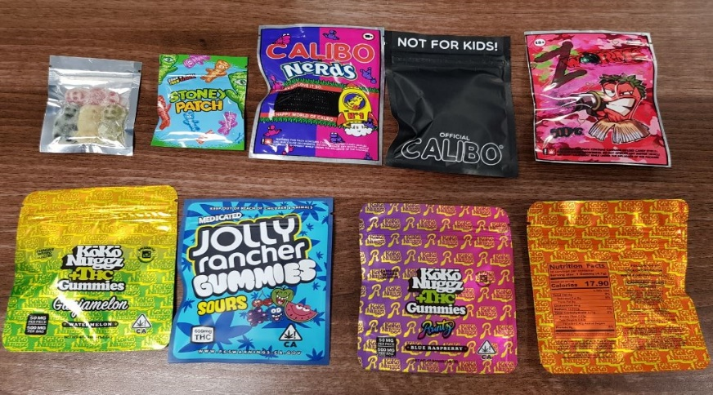
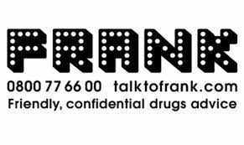
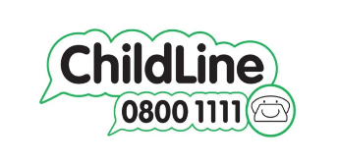

If you think someone is supplying Cannabis edibles in your area please
contact
The Metropolitan Police on 101 or www.met.police.uk
If you prefer to remain anonymous
contact
CrimeStoppers on
0800 555 111

