Slide 1
Welcome
Year 11 Parent Information Evening

Slide 2
Year 11 Information Evening Tuesday 6th November 2018
The aim of this evening is to provide you with details on key events your daughter will need to prepare for this year and how to support her in core subjects:
* Post 16 options and college applications, Ms Kennedy * Professional Interview Day, Ms Philippou * Preparing for GCSEs, Ms Kennedy * English – final preparations/revision strategies, Ms Schaber * Maths – maths mocks, interventions and revision software, Mr Salmon * Science- Tassomai and preparing for exams, Mr Kerr * Summer 2019 NCS engagement, Mr Dominic

Slide 3
College Applications
Level 1 courses –targeted at students achieving grades 1-2 at GCSE
Level 2 courses-targeted at students working towards grades 4
Level 3 courses –targeted at students achieving grade 4 in English and Maths and at least 5 subjects are grade 4 or above
Btec (vocational courses), A level (academic courses) or Apprenticeship (paid on the job learning)

Slide 4
College Applications
College Open Days
Applications –references
College Roadshow: 13th December 2018

Slide 5
Apprenticeships

Slide 7
Preparing for Exams

Slide 8
WSFG Website information

Slide 9
Examination boards

Slide 10
Long term plans

Slide 11
New 9-1 grading system Grade 9!Highest 3% of marks
A* | A*+
 | A*
 | A*-
A | A+
 | A
 | A-
B | B+
 | B
 | B-
C | C+
 | C
 | C-
D | D+
 | D
 | D-
E | E+
 | E
 | E-
F | F+
 | F
 | F-
G | G
U
9
8
7
6
5
4
3
2
1
U

Slide 12
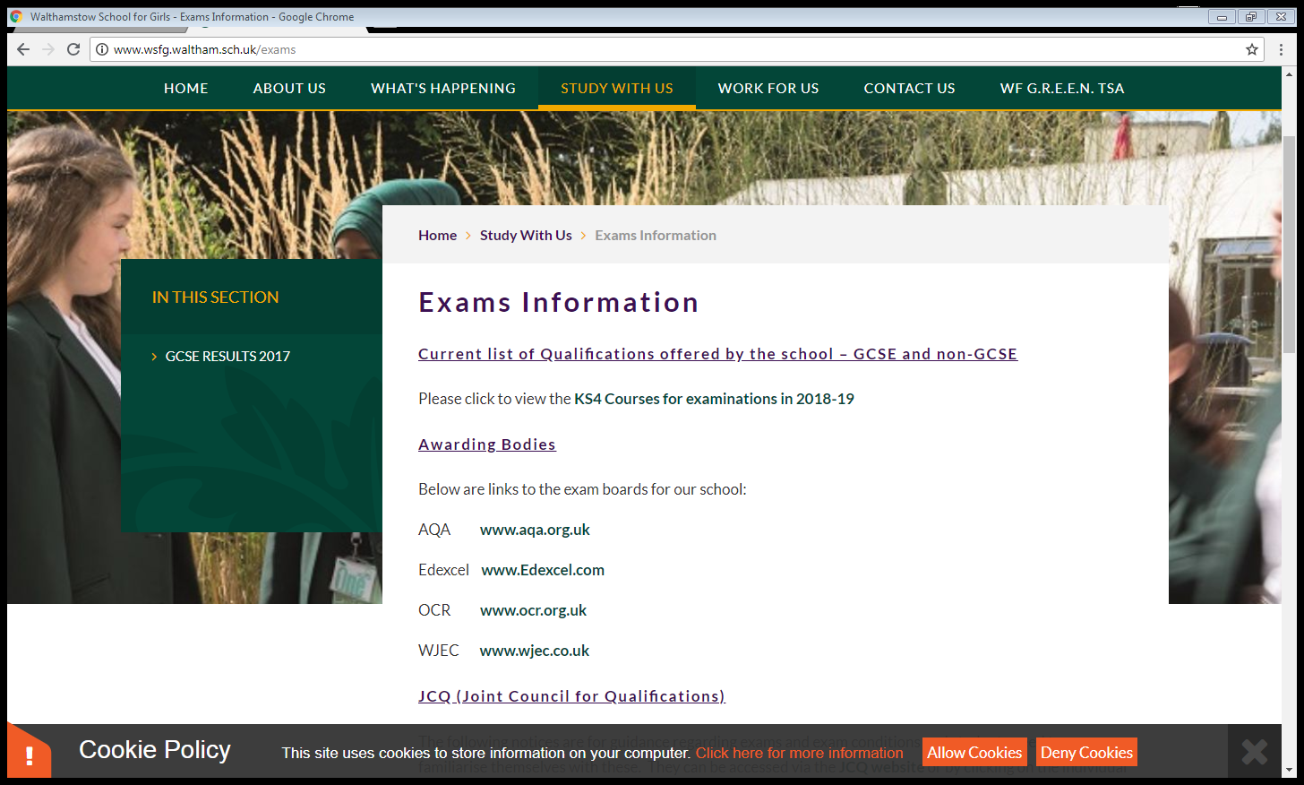
Mock Examinations
5thNovember -30th December

Slide 13
Mock results
Mock Results Day: Wednesday 20th December (period 5)
COURSE INFORMATION BOOKLET
Targeted interventions: compulsory attendance
Mentoring
Parent support meetings

Slide 14
Most important support for achievement
…in the classroom
Good attendance
Good punctuality
Determination
focus

Slide 15
Holidays: managing workload
BTEC
Art/ Music or Design & Technology completing portfolio / composition /Controlled Assessment
All students should aim to master one key Mathematics topic this holiday
Subject | Topic for Mastery
Mathematics

Slide 16
Holiday revision
Easter revision programme
May Half term revision programme
Winchmore Tutors: February Half term; May half term

Slide 17
National Contingency Day: Wednesday 26th June 2019
All students must be available to attend this in the event that any exam has to be rescheduled nationally.

Slide 18
Leaver’s Day Ceremony
Book Returns Date: Friday 28th June

Slide 19
Remarks of GCSE examinations
School identifies borderline students (1 mark away from a grade boundary)
Parental requests can be made

Slide 20
Walthamstow School for Girls
Professional Interview
Friday 1st February 2019
An opportunity to practise applications and interviews

Slide 21
Professional Interview Day - Why?
Preparation for real life - life skills
Understanding how to write a CV and a covering letter
Understanding what job adverts look like in real life
Understand what interviews are like
Thinking about appropriate dress for an interview
Confidence building in interviews
Support for college applications and interviews

Slide 22
Professional Interview Day - What happens?
Preparation in PSHE (booklets, CVs, letter writing, first impressions, what to wear, interview practice)
Come to school in your interview dress
Allocated appointment slots for your interview
Interviews conducted by 21+ volunteers
Your interviewer will have your CV and cover letter
Interviews are around 15-20 mins long
Feedback from interviewer on interview and CV/cover letter
Self -reflection
Normal lessons for the rest of the day

Slide 24
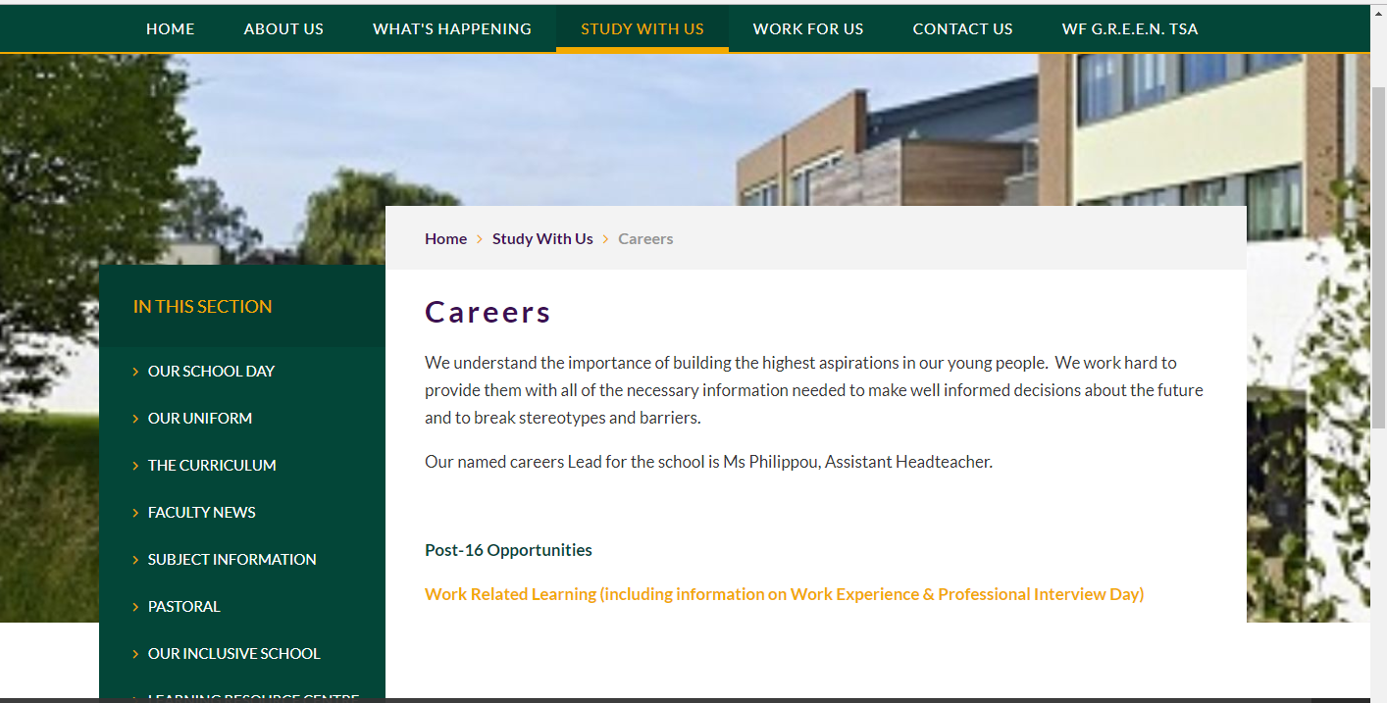

Slide 25
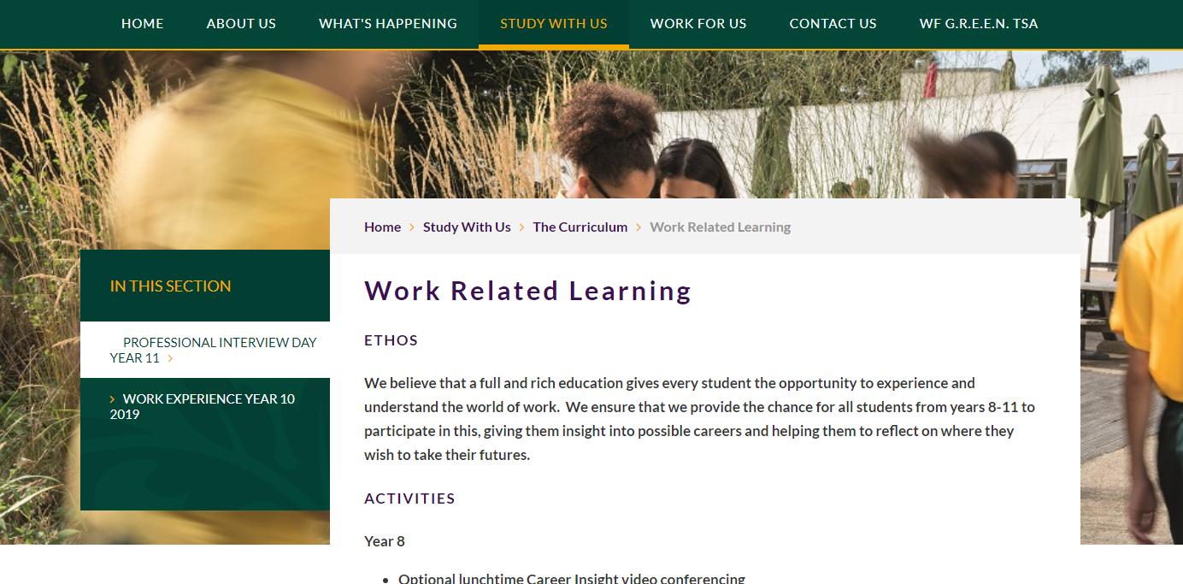

Slide 26
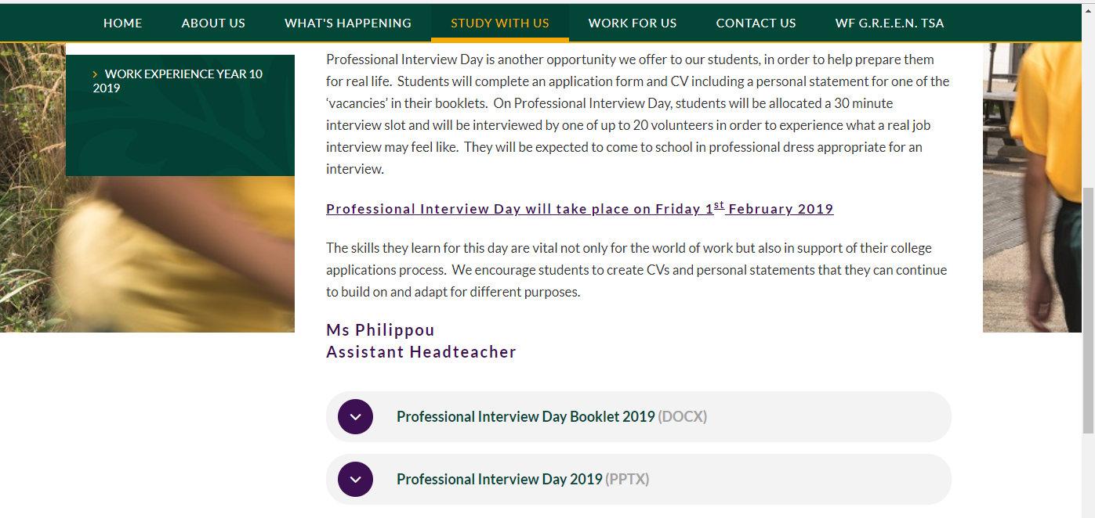

Slide 27
Professional Interview Day - Key dates
Application deadline:
Monday 7th January
Applications printed and handed to Student Services.
Professional Interview Day:
Friday 1st February

Slide 28
Y11 English
Ms Schaber

Slide 29
English Lang Component 1: 40% -Fiction 1hour 45 minutes Section A: Reading Section B: Creative Writing

Slide 30
English Lang Component 2: 60% GCSE -Non-fiction
2 hours
Section A: Reading
Section B: Transactional Writing (x 2)

Slide 31
Literature Component 1: 2 hours (40%)
Romeo and Juliet (Shakespeare)
Extract question
Essay question
Poetry Anthology
2 essay questions (one with comparison)

Slide 32
Literature Component 2: 2 hours 30 minutes (60%)
An Inspector Calls
Source Based Question Essay question
Jane Eyre
Source Based Question
Unseen Poetry

Slide 33
Developing GCSE Language Skills
GCSE Language is often the more difficult paper.
Pupils expected to analyse non-fiction from the 19th, 20th and 21st century, as well as make comparisons between texts.
How to Develop GCSE Language Skills:
Watch documentaries to improve contextual knowledge
Read broadsheet newspapers (in print or online)
Use online revision tools (e.g. BBC Bitesize)

Slide 34
Developing GCSE Literature Skills
GCSE Literature requires in depth understanding of characters, themes and ideas.
Pupils expected to analyse writers’ methods, including contextual factors, to explore writers’ meanings and messages.
How to Develop GCSE Literature Skills:
Revise key texts to keep content in working memory
Revise classwork and checkpoint assessments
Use online revision tools (e.g. BBC Bitesize, Shmoop)

Slide 35
Exam Revision Techniques
Create timelines for each Literature text (Romeo and Juliet, Jane Eyre, and An Inspector Calls).
Create character profiles for the main characters in each text. Brainstorm 5 adjectives to describe their personality; link to at least 10 key quotes. Use cue cards to test your knowledge and memory.
Track how characters change. Create a ‘mini character profile’ for the beginning, middle, and end of the text. Summarise how the character has changed across the text.
Themes: Track key themes across the text. Use the same process as you would for tracking a character.
Extracts: Choose 2 – 3 extracts which you think demonstrate a character or theme well. Practise analysing these extracts. What methods can you identify? What is revealed about a character? What’s the writer’s intention?
Anthology Poetry: revise poems in pairs. Look for poems which have similar tones, messages, or techniques. You should also revise poems in pairs which have opposite ideas (e.g. two poems which have opposite views on war).
Redrafting responses: Look carefully at your Y10 mock exams, Romeo and Juliet checkpoint, and any other assessments and/or extended pieces of writing. What have you done well? What could you have improved? Practise by re-drafting responses to make improvements.
Plan and write practise exam papers (found on WJEC Eduqas website).
Use resources available to you: revision books, BBC Bitesize, Shmoop, Mr Bruff on YouTube.

Slide 36
What you can do to support
Encourage your daughter to watch documentaries and read broadsheet newspapers to improve her language analysis skills.
Encourage your daughter to revise literature texts regularly.
Ask your daughter to summarise key scenes, characters, and themes from her literature texts, to reinforce her own understanding.
Ask your daughter to explain where she scored marks on an assessment, and what she could do to improve her work, to reinforce her understanding of GCSE exam requirements.
Call the school and speak with your daughter’s English teacher, should you have any questions or concerns.

Slide 37
GCSE Maths
Supporting your daughter to achieve her potential
Summer 2019 Year 11

Slide 38
The exam
Paper 1 Non-Calculator May 21st
Paper 2 Calculator June 6th
Paper 3 Calculator June 11th
All exams are 90 minutes
No controlled assessment – 100%
exam
Higher Grades - 4 – 9
Foundation Grades - 1 - 5

Slide 39
How to practice and revise
Use Pinpointlearning.co.uk
Use vle.mathswatch.com
Use Kerboodle.com
Use MyMaths.co.uk
Use PiXL Maths App
Use Revision Guide and Workbook
Use textbook and practice book
Past Exam & walking talking Papers
Websites such as Bitesize, mathsgenie
There are a huge number of resources on the school MLE

Slide 40
WHAT WORKS BEST
Being prepared and focusing properly in lessons
We are setting Past Exam Papers weekly, going through them and assessing them (Pinpoint Learning – Personalised booklets, personalised revision lists and personalised retests)
Any questions that were not answered correctly need to be revised and tried again.
We will be tracking progress using past exam papers and end of chapter tests.
Revise the most common topics first – use the blue topic list (available after mocks)
Short bursts of revision and don’t do a paper all at once (VLE.Mathswatch is great for this)

Slide 41
What parents can do to help
Remind your daughter to attend maths support or intervention sessions on Tuesdays 3:30 to 4:30.
Discuss her successes, for example a good homework or result in a test.
Our LRC has some books for parents and carers explaining how you can help your children with Maths.
Ask your daughter to explain maths questions to you as this reinforces her learning of the topic.

Slide 42
And finally...
Please feel free to call the school if you would like to talk to your daughter’s maths teacher if there is anything that you are not sure about.
Your daughter’s maths teacher will always be happy to help.

Slide 43
Preparing for
Science Exams

Slide 44
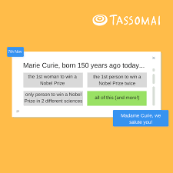
Using Tassomai
There is now an app available for quick easy access
Download and log into it
Complete quizzes for 15 minutes

Slide 46
How do we know it works?
Outgoing year 11: two students with the highest Tassomai usage both achieved a grade 9-9 for Combined Science
Separate Science student with highest Tassomai usage achieved:
Physics: 8
Biology: 9
Chemistry: 9

Slide 47
PHASE 1:
Knowledge
GREEN Skill: Growth & Newness
PHASE 2:
Memorise
GREEN Skill: Resilience
PHASE 3:
Apply
GREEN Skill: Energy

Slide 48
Phase 1: Knowledge
Student overview
Identify topic
Specification
Revision guide / Collins online text book
Exercise book
Revision websites-bitesize, passmyexams, revisionscience, S-cool,
Free Science Lesson videos – YouTube
Teacher
A4 paper/
notebook
Cue cards
Making notes
Brainstorm:
A5 or A4 or A3

Slide 49
How to write a cue card
B1 L2: Eukaryotic vs. Prokaryotic
(Q1)
Compare Eukaryotic cell to Prokaryotic cells
(Q2)
Compare animal cells to plant cells
Notes:
Student should write a question on one side of the cue card
Explain to students how to formulate questions using overview

Slide 50
How to write a cue card
B1 L2: Eukaryotic vs. Prokaryotic
Eukaryotic–definition
Prokaryotic-definition
FUNCTIONS
Cell membrane
Cytoplasm
Animal cell Plant cell
Nucleus
Mitochondria
Ribosome
Cell wall
Vacuole
Chloroplast
Notes:
How to write a cue card:
= Main heading: Chapter, lesson number, lesson title
= ensure lots of white space
= use bullet points
= use highlighters
= keep it basic

Slide 51
Phase 2: Memorise
Look / cover / write
Say it out loud
Repetition
Teach someone else
Verbal memory =
Acronyms
Acrostics
Word associations
Rhymes
Songs
Visual memory =
Images
Diagrams
Words linked to diagrams
Notes:
Reiterate that each student learns and memorises differently. They must find what works for them – experiment and try different methods.

Slide 52
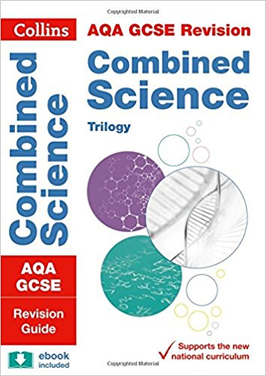
Phase 3: Apply
Revision guide questions
Collins text book questions (accessible online)
Exam questions
Online
MLE
Class resources (exercise books)
Mark schemes
Self-assess
Friends/parents/guardians
Notes:
Emphasise the importance of using, analysing and interpreting mark schemes.

Slide 53
How long for each phase
Phase 1: Making notes 10%
Phase 2: Memorise 20%
Phase 3: Apply 70%

Slide 54
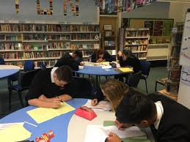
Setting the scene
The following is advice from a neuro-scientist specialising in memory and revision
Avoid distractions eg music, television in the background
Revise in a quiet setting
Revise by yourself not in groups
Repetition in different ways helps build strong memories eg, write it down, draw a picture, answer exam questions on it
Get plenty of sleep
Control your emotions as this affects memory access

